Slide 1
The Authority Control Task List
Yoel Kortick – Senior Librarian

Slide 2
  Introduction
  What does the Authority Control Task List include?
  Accessing and using the Authority Control Task List
  Viewing Tasks
  Linking - BIB heading found no matching AUT headings
  Preferred Term Correction - BIB heading found no authorized term
  Linking – BIB heading found multiple matching AUT headings (ambiguous)
  AUT Record deleted – Unlinked BIB heading
  Preferred Term Correction - BIB heading updated
  Editing Tasks and Process Changes
  Authority Control Task List Set
  Configuring Authority Control Task List Report Types

Slide 3


Introduction

Slide 4
Introduction
The Authority Control Task List provides details regarding the following in relation to the institution's bibliographic record headings:
  Authority record updates
  Authority control process

Slide 5
Introduction
The Authority Control Task List
  Aids the staff user in managing cataloging maintenance tasks.
  Highlights authority headings updates that require manual intervention.

Slide 6

What does the Authority Control Task List include?

Slide 7
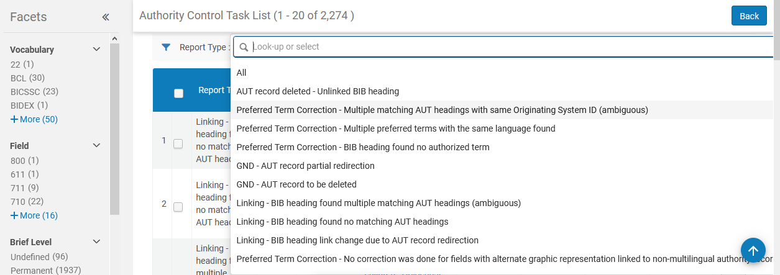
What does the Authority Control Task List include?

Slide 8
What does the Authority Control Task List include?
For a full list of the various tasks in the Authority Control Task List, with a description, see Viewing Tasks in Using the Authority Control Task List.

Slide 9

Accessing and using the Authority Control Task List

Slide 10
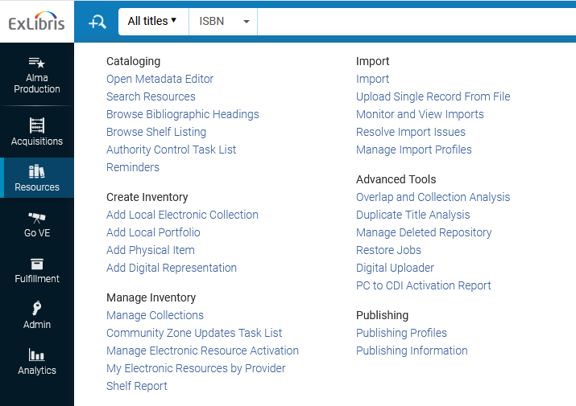
Accessing and using the Authority Control Task List

Slide 11
Accessing and using the Authority Control Task List
From the Authority Control Task List page, you can choose to view the tasks from
The Review tab
  Contains a list of all the tasks that require some action
The All tab.
  Displays all the tasks that have not yet been dismissed.

Slide 12
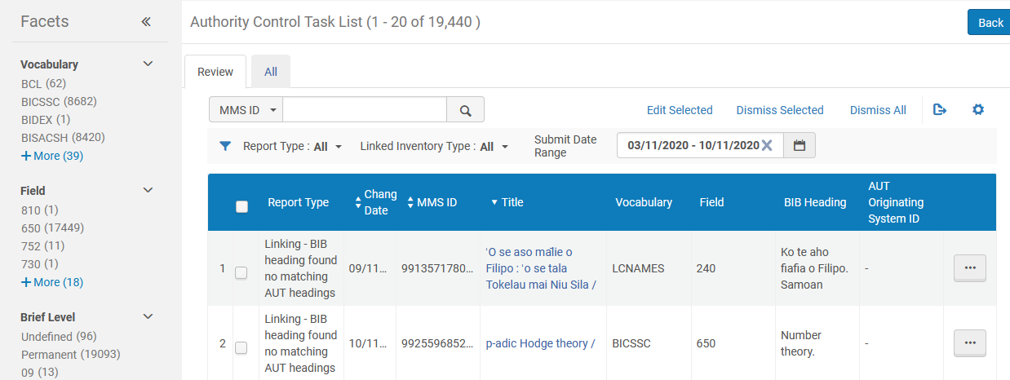
Accessing and using the Authority Control Task List
The two tabs

Slide 13
Accessing and using the Authority Control Task List
The lists on the "Review" tab and "All" tab can be filtered using the options below.
Facets
Report Type
Linked Inventory Type
Submit Date Range

Slide 14
Accessing and using the Authority Control Task List
4 ways to filter the list

Slide 15

Viewing Tasks

Slide 16
Viewing Tasks
To view tasks in the Authority Control Task List:
Open the Authority Control Task List page.
Select the Review or All tab.
Filter by Report Type, Linked Inventory Type, or Submit Date Range to view the tasks upon which you want to focus.
For a description of the tasks see "Report Type Filtering Options" at Using the Authority Control Task List

Slide 17
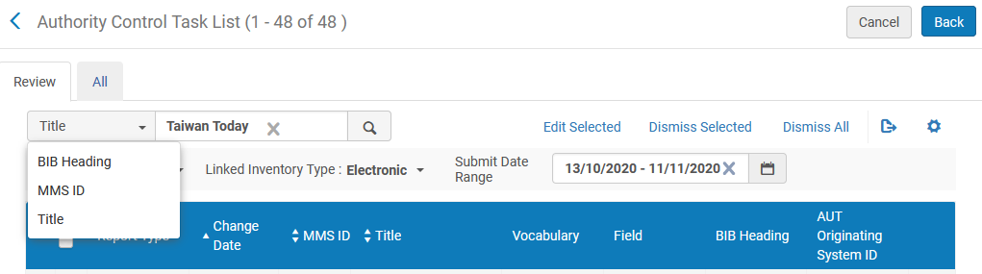
Viewing Tasks
It is possible to search for a specific record's task

Slide 18
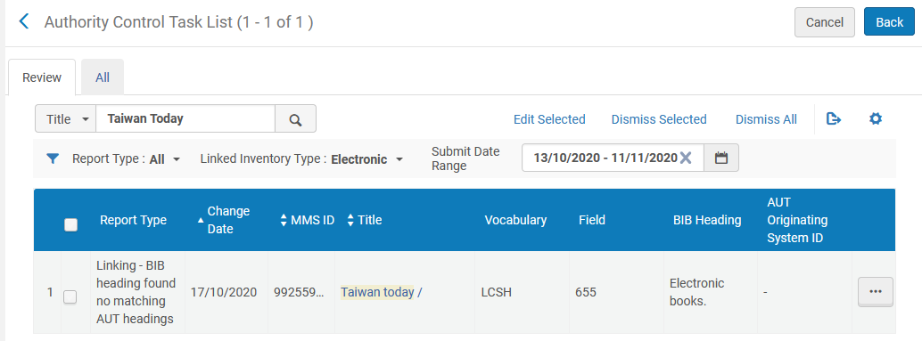
Viewing Tasks
Here we have searched for and found title "Taiwan today"

Slide 19
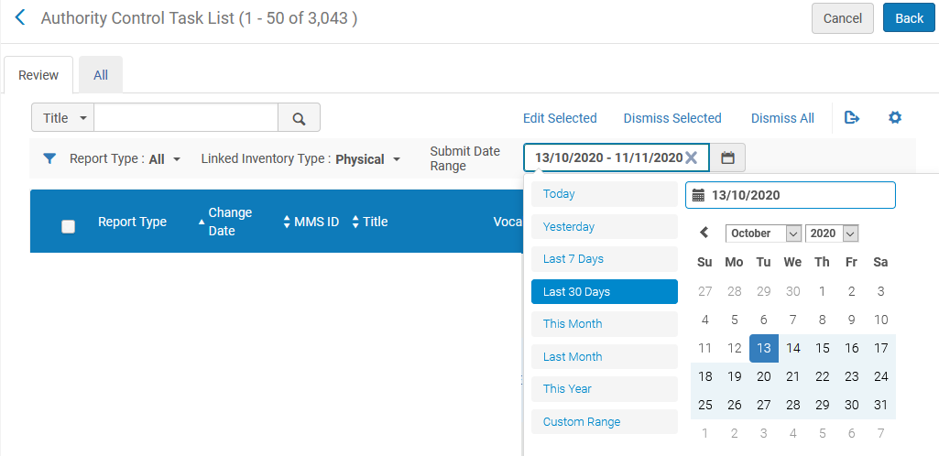
Viewing Tasks
Here we search for all entries with record change in the last 30 days for records with physical inventory.

Slide 20
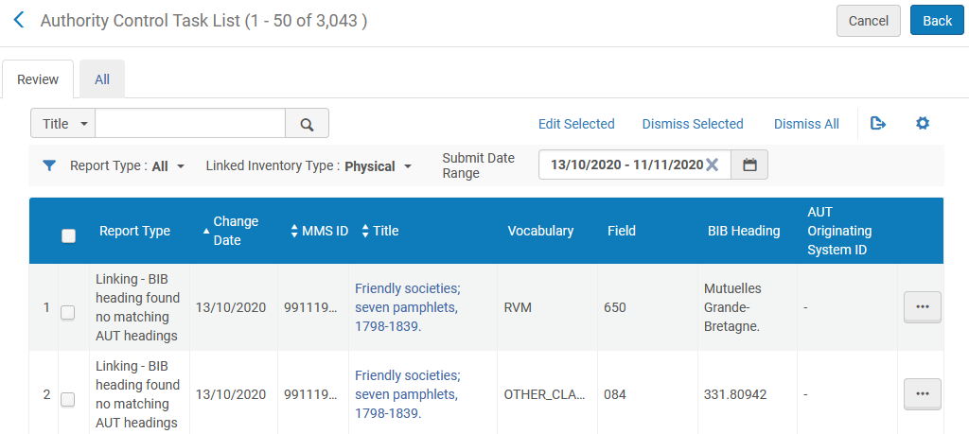
Viewing Tasks
Here we have retrieved for all entries with record change in the last 30 days for records with physical inventory.

Slide 21
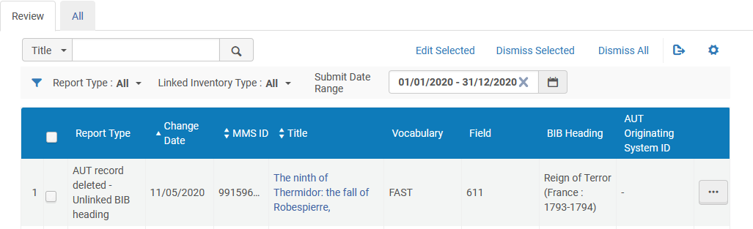
Viewing Tasks
Note that the authority control tasks are kept only for the most recent 6 months. Thus, filtering by Date Range is limited to the last 6 months.
For example on Nov. 11, 2020 the oldest possible task will be from May 11, 2020

Slide 22
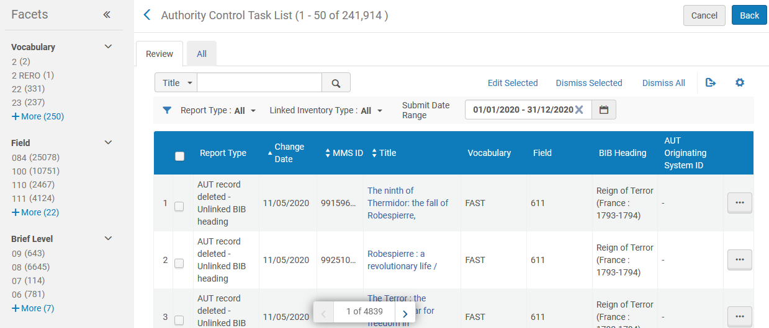
Viewing Tasks
It is also possible to filter the tasks by one of the many facets

Slide 23
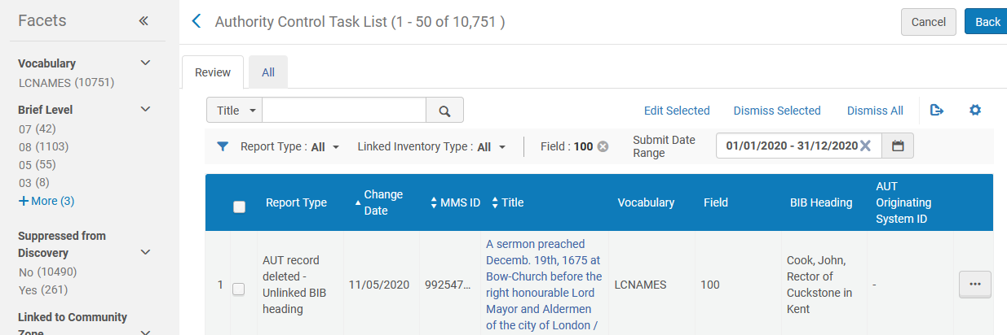
Viewing Tasks
Here we have faceted by tasks on field 100

Slide 24

Linking - BIB heading found no matching AUT headings

Slide 25
Linking - BIB heading found no matching AUT headings – example 1
Type: Linking - BIB heading found no matching AUT headings
This is defined as follows:
This option references attempts to find a link between a heading in the bibliographic record and an authority headings record. When no matching authority headings record is found, you may want to review the information in the bibliographic record.

Slide 26
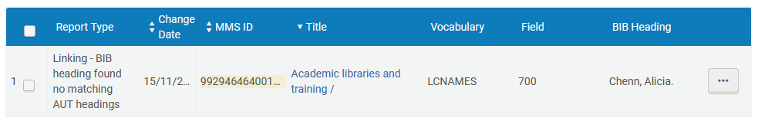
Linking - BIB heading found no matching AUT headings – example 1
In this example text "Chenn, Alicia" is in field 700 and should match LCNAMES vocabulary.

Slide 27
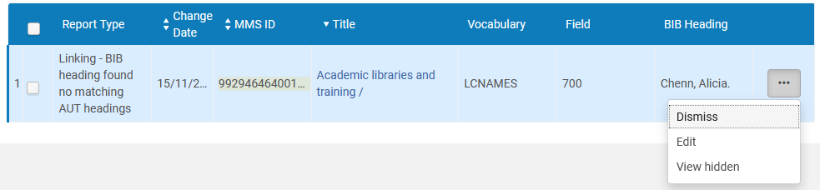
Linking - BIB heading found no matching AUT headings – example 1
From the authority control task list we will open the record in the metadata editor

Slide 28
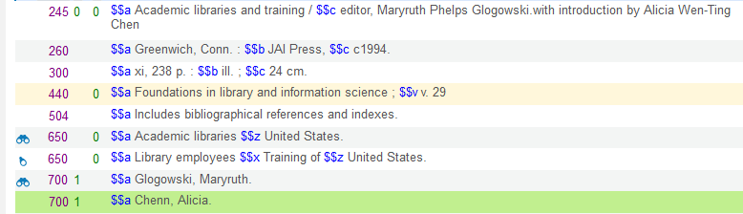
Linking - BIB heading found no matching AUT headings – example 1
The specific field is highlighted automatically in a different color

Slide 29
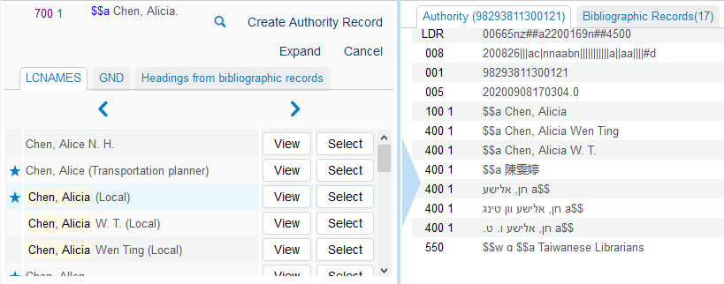
Linking - BIB heading found no matching AUT headings – example 1
If we do F3 we see that it should have been entered as "Chen, Alicia" (one 'n' instead of two).

Slide 30
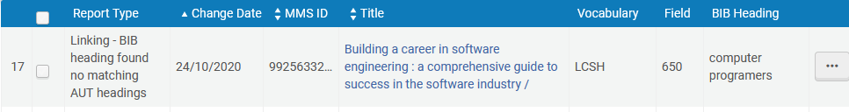
Linking - BIB heading found no matching AUT headings – example 2
Let’s look at another example.
In this example text "computer programers" (with spelling error in "programmers") is in field 650 and should match LCNAMES vocabulary.

Slide 31
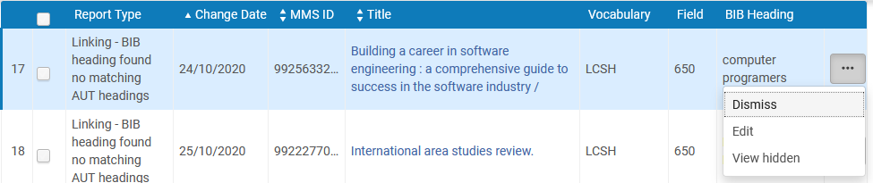
Linking - BIB heading found no matching AUT headings – example 2
From the authority control task list we will open the record in the metadata editor

Slide 32
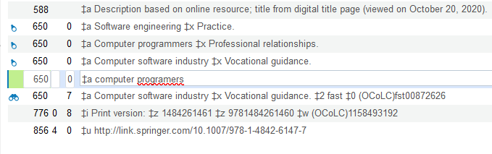
Linking - BIB heading found no matching AUT headings – example 2
The 2nd indicator "0" in the 650 field means that this is LCSH vocabulary. However, "computer programers" does not exist as a heading in LCSH

Slide 33
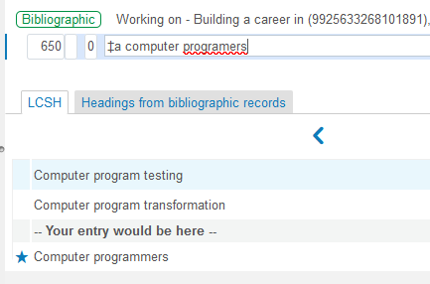
Linking - BIB heading found no matching AUT headings – example 2
If we do F3 we see that it should have been entered as "Computer programmers"

Slide 34
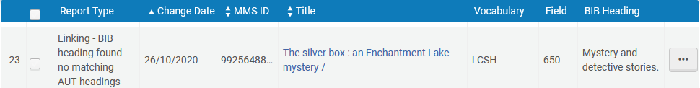
Linking - BIB heading found no matching AUT headings – example 3
Here is another example of "Linking - BIB heading found no matching AUT headings"
Text "Mystery and detective stories" is in 650 and should link to LCSH vocabulary.

Slide 35
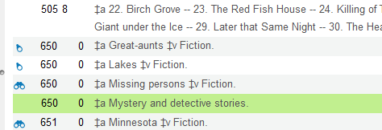
Linking - BIB heading found no matching AUT headings – example 3
The 650 has 2nd indicator "0" indicating that it should exist in the LCSH vocabulary.

Slide 36
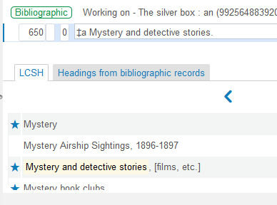
Linking - BIB heading found no matching AUT headings – example 3
If we do F3 we see that the text should have been added as "Mystery and detective stories, [films, etc.]"

Slide 37

Preferred Term Correction - BIB heading found no authorized term

Slide 38
Preferred Term Correction - BIB heading found no authorized term – Example 1
Type: Preferred Term Correction - BIB heading found no authorized term
This is defined as follows:
This option references updates to the bibliographic record with the value of the preferred term of the linked authority record. When the linked authority record does not have a preferred term matching the nonpreferred term (such as when the nonpreferred term is registered in the 410 field and the preferred term is in the 100 field), the bibliographic record is not updated.

Slide 39
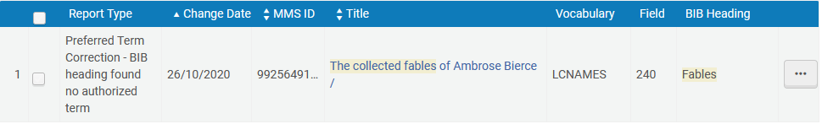
Preferred Term Correction - BIB heading found no authorized term – Example 1
Type: Preferred Term Correction - BIB heading found no authorized term
In this example text "Fables" is in field 240 and should match LCNAMES vocabulary.

Slide 40
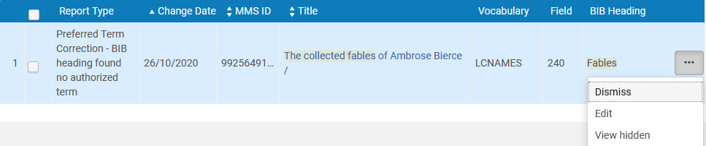
Preferred Term Correction - BIB heading found no authorized term – Example 1
From the authority control task list we will open the record in the metadata editor

Slide 41
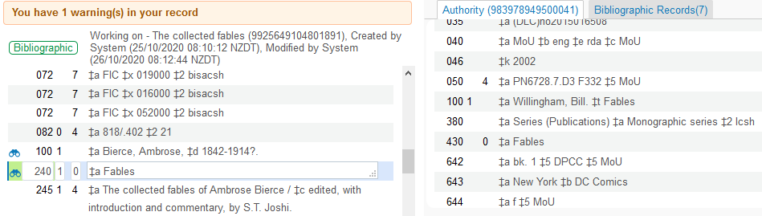
Preferred Term Correction - BIB heading found no authorized term – Example 1
We see that "Fables" is a non preferred term. It has not been updated to the preferred term. The preferred term is in a 100 field and the non preferred term is a 430.

Slide 42
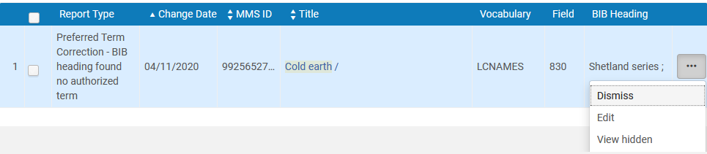
Preferred Term Correction - BIB heading found no authorized term – Example 2
Here is another example of type "Preferred Term Correction - BIB heading found no authorized term"
In this example text "Shetland series ;" is in field 830 and should match LCNAMES vocabulary.

Slide 43
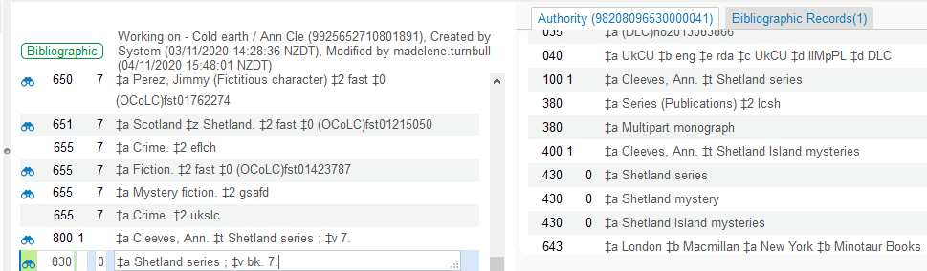
Preferred Term Correction - BIB heading found no authorized term – Example 2
We see that "Shetland series ;" is a non preferred term. It has not been updated to the preferred term. The preferred term is in a 100 field and the non preferred term is a 430.

Slide 44

Linking - BIB heading found multiple matching AUT headings (ambiguous)

Slide 45
Linking - BIB heading found multiple matching AUT headings (ambiguous) – Example 1
Type: Linking – BIB heading found multiple matching AUT headings (ambiguous)
This is defined as follows
This option references attempts to find a link between a heading in the bibliographic record and an authority headings record. In some cases, multiple matches are found. You need to review the possible matches to decide which is the correct one.

Slide 46
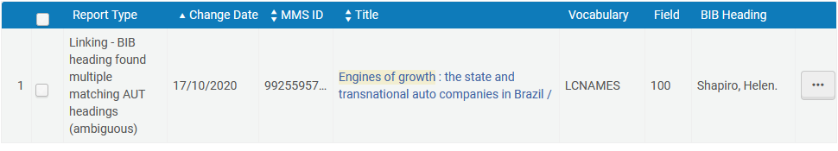
Linking - BIB heading found multiple matching AUT headings (ambiguous) – Example 1
In this example text "Shapiro, Helen" is in field 100 and should match one entry in the LCSH vocabulary, but has multiple matches

Slide 47
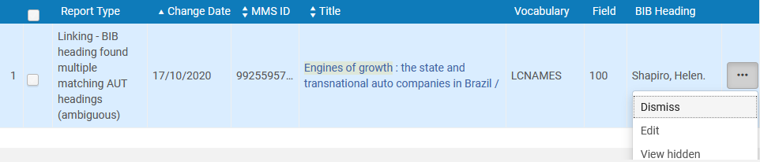
Linking - BIB heading found multiple matching AUT headings (ambiguous) – Example 1
From the authority control task list we will click "Edit" to get to the list of authority headings

Slide 48
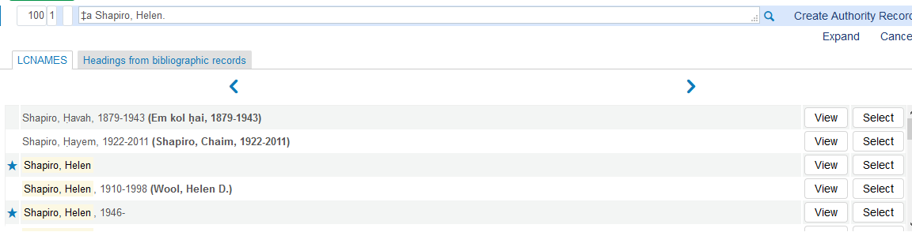
Linking - BIB heading found multiple matching AUT headings (ambiguous) – Example 1
The text "Shapiro, Helen" appears multiple times with different dates. It was entered in the bibliographic record without dates.

Slide 49
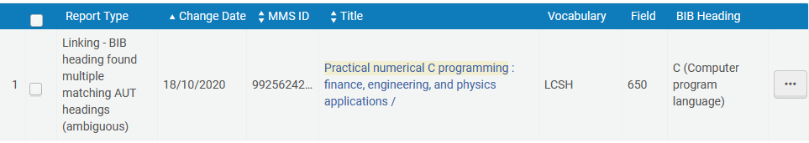
Linking - BIB heading found multiple matching AUT headings (ambiguous) – Example 2
Type: Linking – BIB heading found multiple matching AUT headings (ambiguous)
In this example text "C (Computer program language)" is in field 650 and should match one entry in the LCSH vocabulary, but has multiple matches

Slide 50
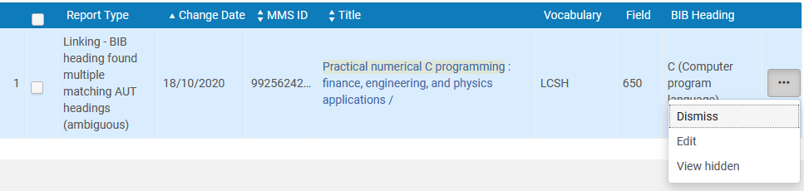
Linking - BIB heading found multiple matching AUT headings (ambiguous) – Example 2
From the authority control task list we will click "Edit" to get to the list of authority headings

Slide 51
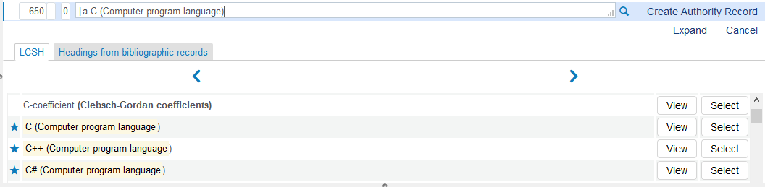
Linking - BIB heading found multiple matching AUT headings (ambiguous) – Example 2
The text "C (Computer program language)" would also match text "C++ (Computer program language)" and text "C# (Computer program language)".
The + and # are not used in the matching

Slide 52

AUT Record deleted – Unlinked BIB heading

Slide 53
AUT Record deleted – Unlinked BIB heading – example 1
Type: AUT Record deleted – Unlinked BIB heading
This is defined as follows
This option references authority records that have been deleted and manual handling may be needed.

Slide 54
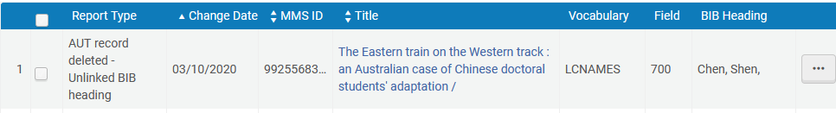
AUT Record deleted – Unlinked BIB heading – example 1
In this example the heading "Chen, Shen," was linked to an authority record, but then the authority record was deleted and therefore the heading was unlinked.

Slide 55
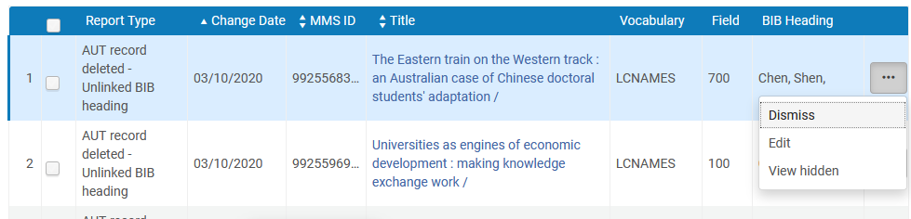
AUT Record deleted – Unlinked BIB heading – example 1
From the authority control task list we will click "Edit" to get to the record and see what happened

Slide 56
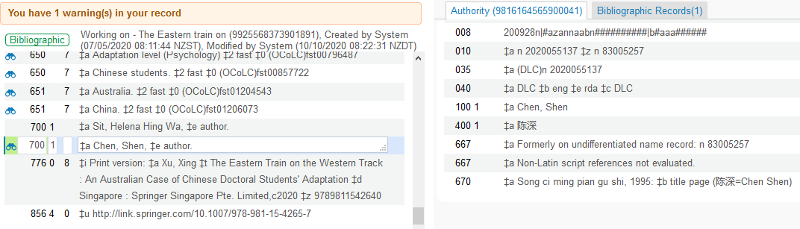
AUT Record deleted – Unlinked BIB heading – example 1
We see that in this case the record is linked an authority record, but it is a different one than it used to be linked to

Slide 57
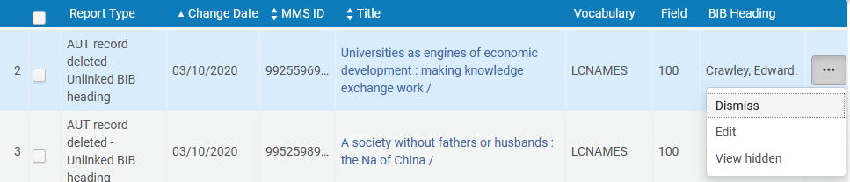
AUT Record deleted – Unlinked BIB heading – example 2
Now let's take a look at heading "Crawley, Edward" from field 100

Slide 58
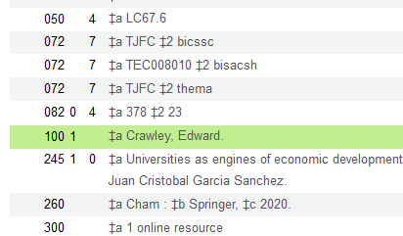
AUT Record deleted – Unlinked BIB heading – example 2
The heading is no longer linked (because the authority record was deleted)

Slide 59

Preferred Term Correction - BIB heading updated

Slide 60
Preferred Term Correction - BIB heading updated
Type: Preferred Term Correction - BIB heading updated
This appears in the "all" tab
This is defined as follows:
This option references updates to the bibliographic record with the value of the preferred term of the linked authority record. When this update is successful, the entry shows the value of the bibliographic record before and after the change.
When an authority record is deleted, it is unlinked from the bibliographic headings it used to match. An entry for each such link shows the link prior to its deletion.

Slide 61
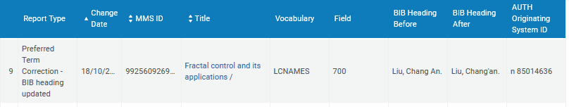
Preferred Term Correction - BIB heading updated
In the example below the heading changed from "Liu, Chang An." to "Liu, Chang'an."

Slide 62
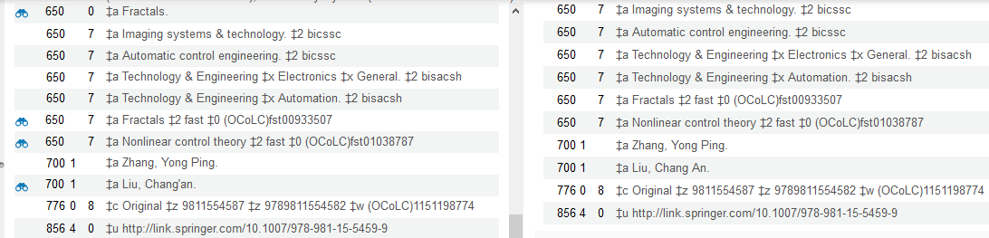
Preferred Term Correction - BIB heading updated
If we edit the bibliographic record and do 'tools > view versions" we can see the change (current record on left, older version on right)

Slide 63

Editing Tasks and Process Changes

Slide 64
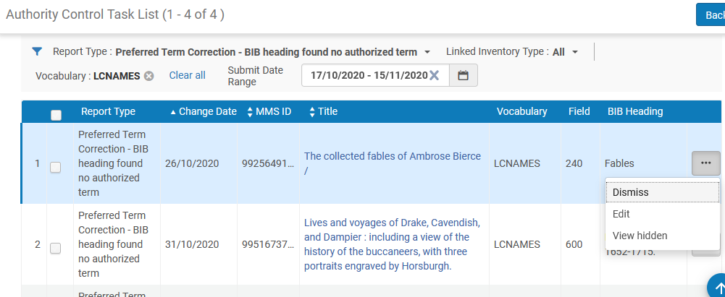
Editing Tasks and Process Changes
From the Authority Control Task List it is possible to edit the record or heading to which the task refers via the row actions:

Slide 65
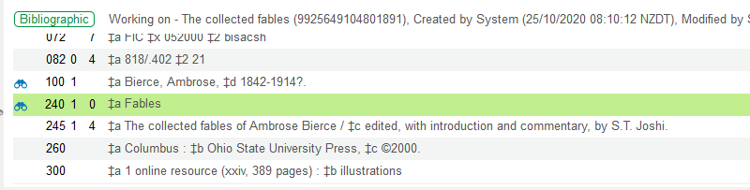
Editing Tasks and Process Changes
The record is opened in the MD Editor to the field that has the issue and highlights that field with a different background color. If there are additional fields in the record with issues, they are also highlighted in a different color.

Slide 66
Editing Tasks and Process Changes
From the Authority Control Task List page when you are finished with the task(s), you can select Dismiss from the row actions list.

Slide 67
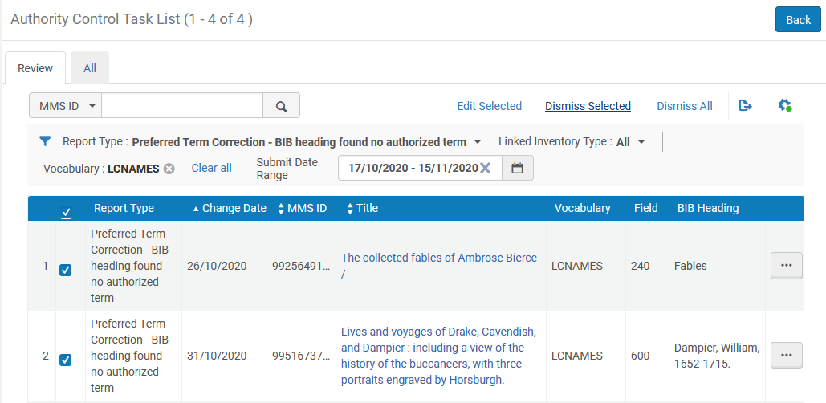
Editing Tasks and Process Changes
You can also dismiss multiple records across multiple pages, up to 100 records by selecting the row check box in the check box column and choosing Dismiss Selected.

Slide 68
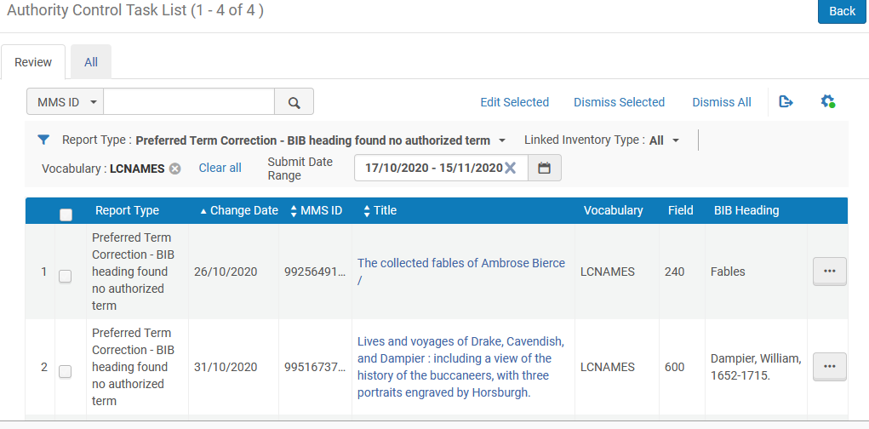
Editing Tasks and Process Changes
You may choose to remove all tasks that are available from the Authority Control Task List page regardless of the tab (Review tab or All tab) on which they may appear.
When you are viewing the Review tab, Dismiss All is available as a page action.
Select "Dismiss All" to remove all tasks available from the Authority Control Task List.

Slide 69
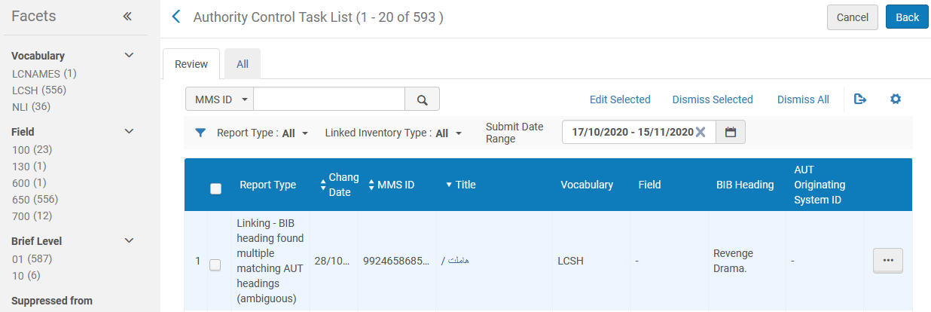
Editing Tasks and Process Changes
From the 'Review" tab we click "Dismiss All“ for all 593 tasks

Slide 70
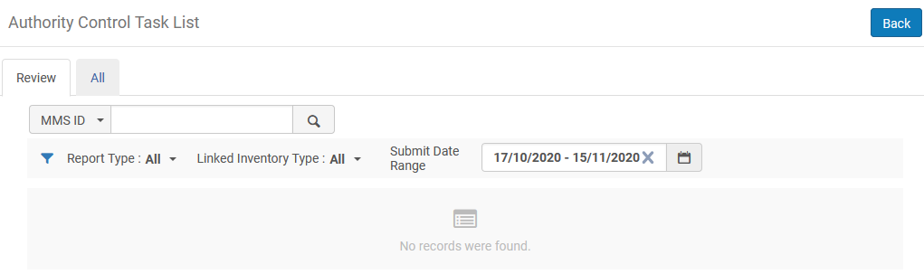
Editing Tasks and Process Changes
All tasks have been removed from the 'Review" tab

Slide 71
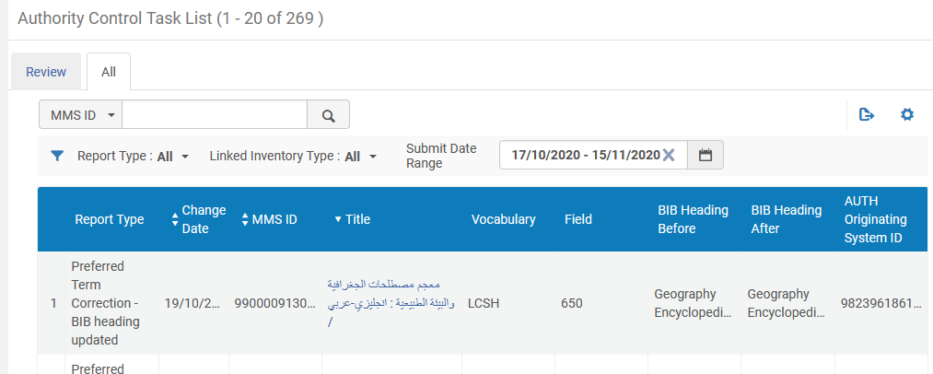
Editing Tasks and Process Changes
Even after "Dismiss All" the "Preferred Term Correction - BIB heading updated" tasks still appear in the "All" tab.

Slide 72

Authority control task list set

Slide 73
Authority control task list set
In the March 2021 release of the new metadata editor it is possible to edit multiple entries from the authority control task list.
All of the edited entries will go into a dedicated set.
This dedicated set then appears in the new metadata editor.
This enables the staff user to handle multiple entries from the authority control task list in the new metadata editor in an efficient and organized manner.
On the next slide we edit multiple records.

Slide 74
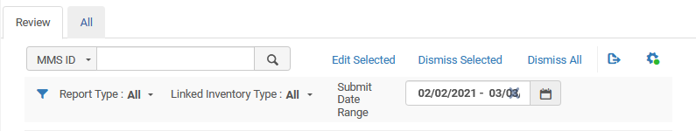
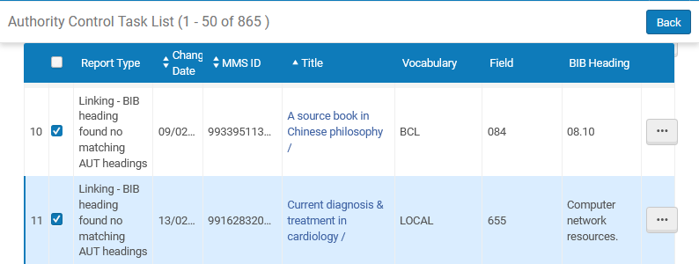
Authority control task list set

Slide 75
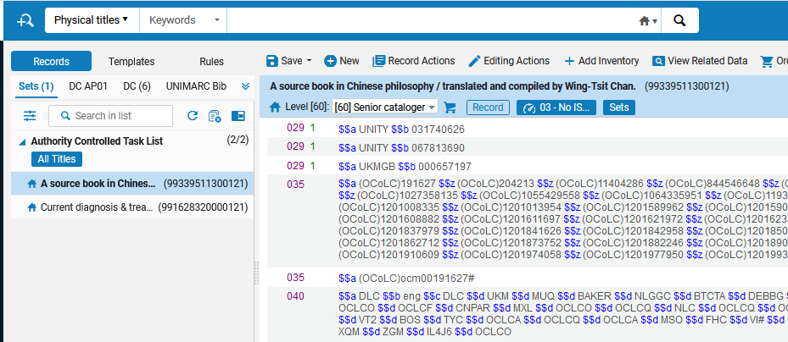
Authority control task list set
Brief level indicator
The records are added to a dedicated set called “Authority Controlled Task List”

Slide 76

Configuring Authority Control Task List Report Types

Slide 77
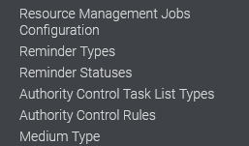
Configuring Authority Control Task List Report Types
It is possible to define which report types will appear in the Authority Control Task List.
This is done via the "Authority Control Task List Types" menu option under Configuration > Resources > General

Slide 78

Configuring Authority Control Task List Report Types
Only the 'Enabled' tasks will appear in the Task List

Slide 79
xxx@exlibrisgroup.com

